Slide 1

Capacity Building;
Studies from the Eastern Part of Norway

Slide 2
Centre for studies of educational practice (SePU
The primary goal of SePU is to initiate and carry out research and development work in partnerships with school districts in Norway and Denmark.
SePU’s primary strategy is to combine school improvement and collecting data for research.
This data is used to develop research­‐based knowledge, and also feeds back to the schools for their analyses and improvement.
Inland Norway University of Applied Sciences

Slide 3
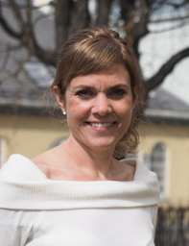

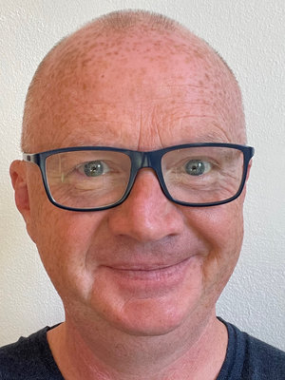
Ann Margareth Gustavsen
Associate Professor
Research interest: School leadership, capacity building, data use, gender differences in academic achievement
Hilde Forfang
Associate Professor
Research interest: School ownership (district leadership), school leadership, organizational- and interorganizational learning
Lars Arild Myhr
Centre Director
Research interest: Incluison, School climate, School improvement, Data-use, School leadership

Slide 4
www.inn.no/sepu
https://nb-no.facebook.com/inn.sepu/
https://netressurs-prod-app-service.azurewebsites.net/
https://e.sepu.no/

Slide 5

Norway

Slide 6
Introduction
Capacity Building; Studies from the Eastern Part of Norway
In order, for students to be able to realize their full potential for learning, it is important that the school continuously improves its capacity for reaching its full potential (Fullan, 2009).
Notes:
In order, for students to be able to realize their full potential for learning, it is important that the school continuously improves its capacity for reaching its full potential (Fullan, 2009). This applies for everyone, from school owners (district leaders), school leaders and teachers with a common goal of improving students' learning (Leithwood & Louis, 2012; Stoll, 2009). Focusing on capacity building is important for several reasons. First, increased capacity will give teachers, school leaders and school owners the opportunity to continuously learn from a rapidly changing world, and to be able to transfer this knowledge to new situations. Furthermore, capacity is closely linked to being ready for change, because capacity is about the prerequisites the school has for implementing school development projects (Oterkiil & Ertesvåg, 2012). Capacity includes both abilities, knowledge and action.

Slide 7
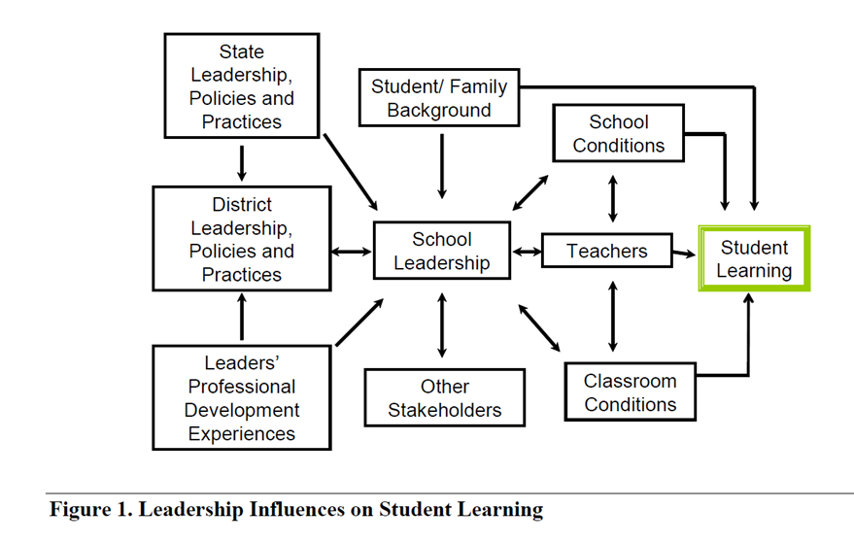
Capacity building at various levels.
1. Relationships and Interactions Between School Owners and School Principals
2. Combining Capacity for Instructional Leadership with Individual Core Practices in the Norwegian Policy Context
3. Support from Universities, by web-based Knowledge Resource a Tool in School-based Professional Development
(Louis, Leithwood, Wahlstrom and Anderson (2010, p. 15)
Notes:
As this figure indicates, features of state and district policies, practices and other characteristics interact with one another and exert an influence on what school leaders do. These features also influence conditions in schools, classrooms and professional community of teachers. Other stakeholder groups, including the media, unions and professional associations also influence school leadership practices. And of course leaders are influenced by their own professional learning and by student family backgrounds.
In this symposium, it will be focused on capacity building at various levels. First Hilde will focus on Relationships and Interactions Between School Owners and School Principals, then Lars will tell you about research finding from a study called Combining Capacity for Instructional Leadership with Individual Core Practices in the Norwegian Policy Context, conducted by anther researcher at SePU. Finally an will focus on use of web-based knowledge resources in competence development.

Slide 8
Symposium
  Small-group interactions
  Discussions
Sum-ups
The purpose of this symposium is to present our research and further get feedback on the following questions:
- How can the research from this case study be used in other contexts and systems?
- Which other perspectives could be used to bring this field forward?
How can the research from this case study be related to your contexts and systems?
Which other perspectives could be used to bring this field forward?
Notes:
Tore

Slide 9
Presentation 1
Relationships and interactions between school owners
and school principals

Slide 10
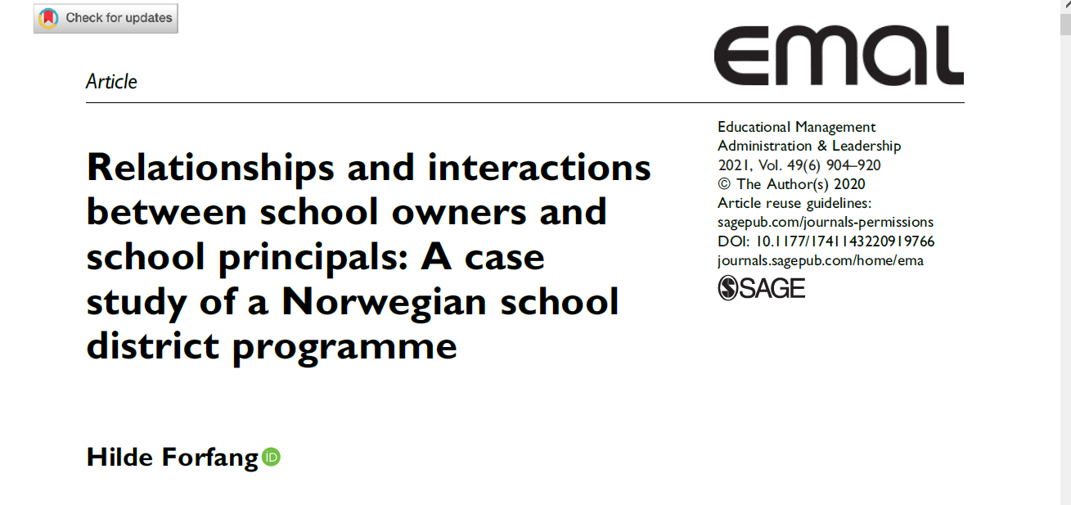
“school owner”: a variety of political and administrative roles performed by municipalities and counties in the Norwegian school governing system.

Slide 12
Rural Norway
About half of the municipalities in Norway consist of fewer than 5,000 inhabitants (Farstad, Rye & Almås, 2009; Kampevoll, 2017; Statistisk Sentralbyrå, 2021a)
Rural; consisting of small towns, rural communities and scattered settlements in typical agricultural and forestry regions (Solstad & Andrews, 2020; Norwegian Directorate of Education, 2011)

Slide 13
Challenges often faced by schools in rural areas
  lack of capacity at municipal level to provide the schools with adequate support,
  principals have to fulfil a wide range of tasks and responsibilities
  lack of staff, time or experience to apply for central grants for school improvement
  the risk of professional isolation and limited access to professional learning
  (Echazarra & Radinger, 2019; OECD, 2018);

Slide 14
Research question
What characterizes the relationships and interactions between municipal school owners and principals in high performing schools with sustainable results in a rural part of Norway?
to attain in-depth insight to the interactions, structures and processes through which system leaders in small rural municipalities deal with the challenges of supporting their school effectively

Slide 15
Context of the study
“The triad” (three neighbour municipalities) subjected to this study consist of approx. 1200 students nested in 10 primary or lower secondary schools, 160 teachers and 13 school leaders.
At the regional or county level, educational outcomes have been below national standards for a period of several decades (Directorate for Education and Training, 2017; Statistics Norway, 2018).
The triadic municipalities have consistently raised their levels of student learning achievements (profile as raising above average).

Slide 16
Some key findings
very high scores when it came to principals’ job satisfaction and opportunity for self-development
a good collaborative and supportive climate between the triadic principals and the municipal school owners
the triadic principals gave strong assessments of their engagement in networking with principals from other schools
representatives from the school-owner level described principals as dedicated, talented, hardworking and development-oriented leaders

Slide 17
a sustainable educational infrastructure and with a joint superintendent for the triadic municipalities
the infrastructure also includes a network of six municipalities (regional network)
number of different arenas for interactions between school owners and principals: seminars, workshops, triadic principal meetings, regional principal meetings, school development projects and follow-up meetings and supervision

Slide 18
the joint superintendent:
great trust that the superintendent is acting on behalf of the municipal council and the municipal director, based on long-term high-performing school results and former skilled and highly respected superintendents.
  was head of schools in own municipality,
  leader of the formal cooperation between the municipalities in the triad, and coordinated the network of six municipalities
  the link between the triad and the County Governor, the Education Directorate and the Norwegian Association of Local and Regional Authorities
  strongly involved in school development and professional learning in the triadic municipalities and across the school district.

Slide 19
Implications for school district policy and practice
district leaders should prioritize building systemic competence and a purposefully tailored infrastructure to reinforce interactions and relationships with their principals
collaborations on school leadership across boundaries
professional networks for interorganizational learning
importance of system leadership

Slide 20
This study indicates that some of the challenges schools in rural regions face can be minimized by collaboration between municipalities by sharing leadership, resources, knowledge and experience across municipalities

Slide 21
Reflections
What is your understanding of the study?
How does the study relate to your context?

Slide 22
Presentation 2

Slide 24
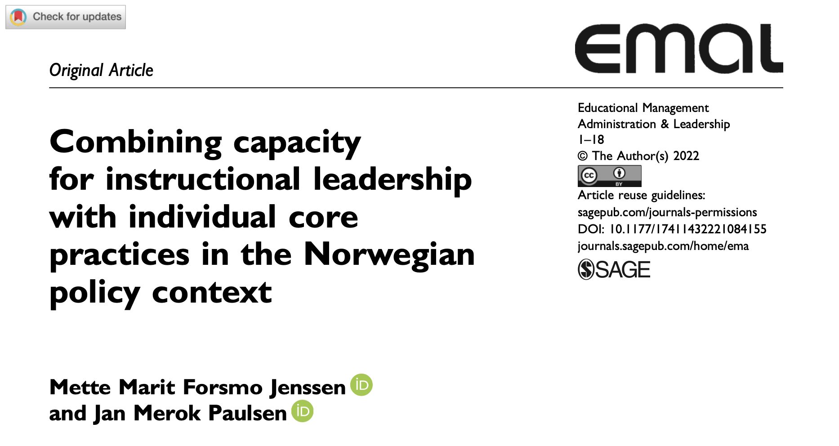
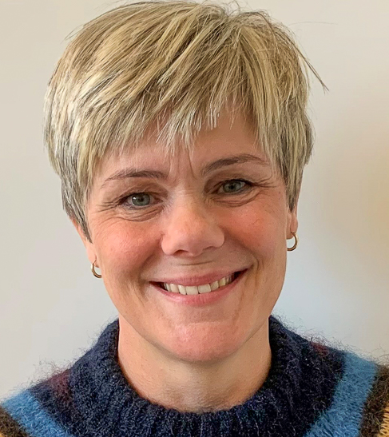


Slide 25
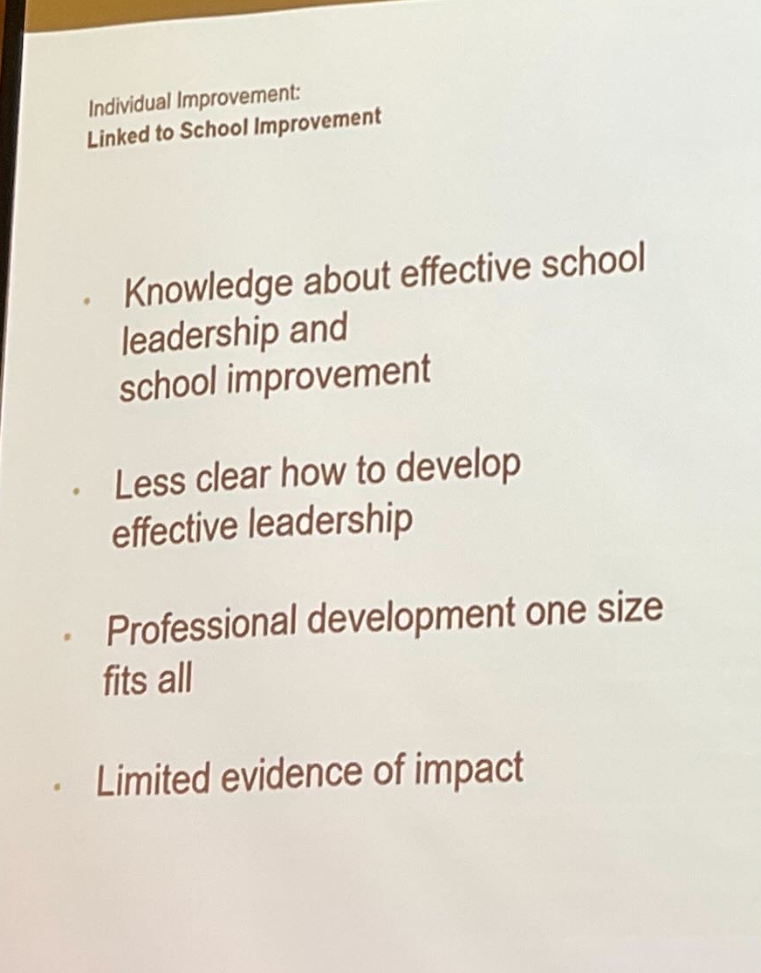
Despite researchers’ and practitioners’ agreement regarding the importance of instructional leadership, how instructional leadership can be developed as a distinct set of capabilities remains unclear.
Page 2
Ellen Goldring, wednsday this week

Slide 26
From previous article
Teachers perception of instructional leadership...
has significant explanatory value to...
Teachers perception of professional learning communities

Slide 27
Instructional leadership
(Hallinger & Heck, 2010), (Robinson (2011), Skaalvik (2020), (Hallinger & Kovacevic, 2021).
...evolved from a strong, directive leadership style focused on curriculum and instruction to a more collaborative style that emphasizes various forms of teamwork while centered on teacher instruction and student learning.
  Page 4

Slide 28
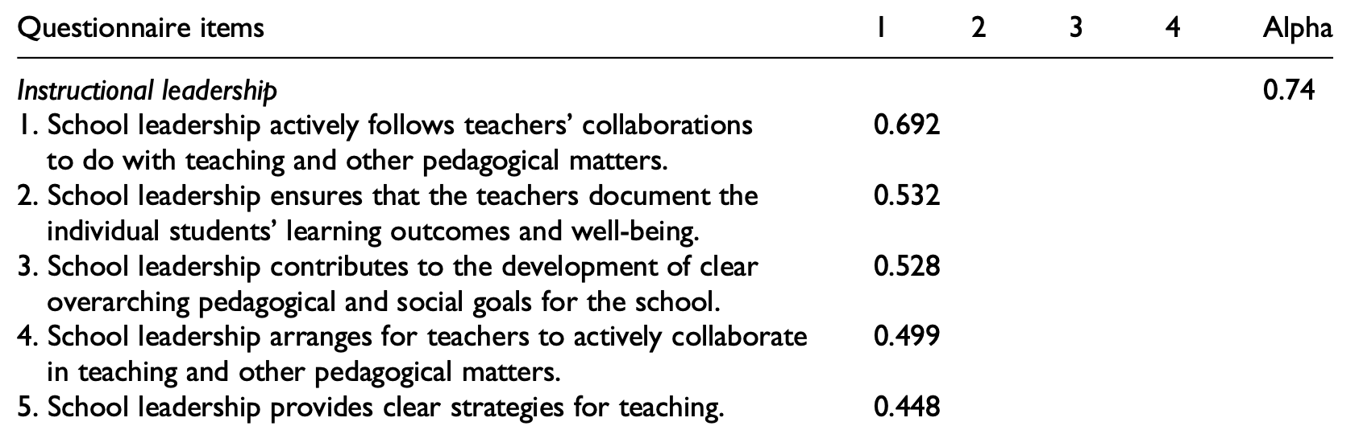
N=

Slide 29
The research question of this study:
To what extent do school leaders’ core practices* predict their capacity for instructional leadership?
* Leithwood (2012), Leithwood et al. (2020a)

Slide 30
Core practices
Leithwood (2012), Leithwood et al. (2020a)
Leithwood distinguished practice from competence by stating that competencies depend on the individual leader’s knowledge, attitudes, and skills, whereas practice takes into account the context in which these skills are activated and adapted.
Core practices of school leadership views school leaders as goal oriented and actively involved in teachers’ collaboration and professional development and other pedagogical matters.

Slide 31
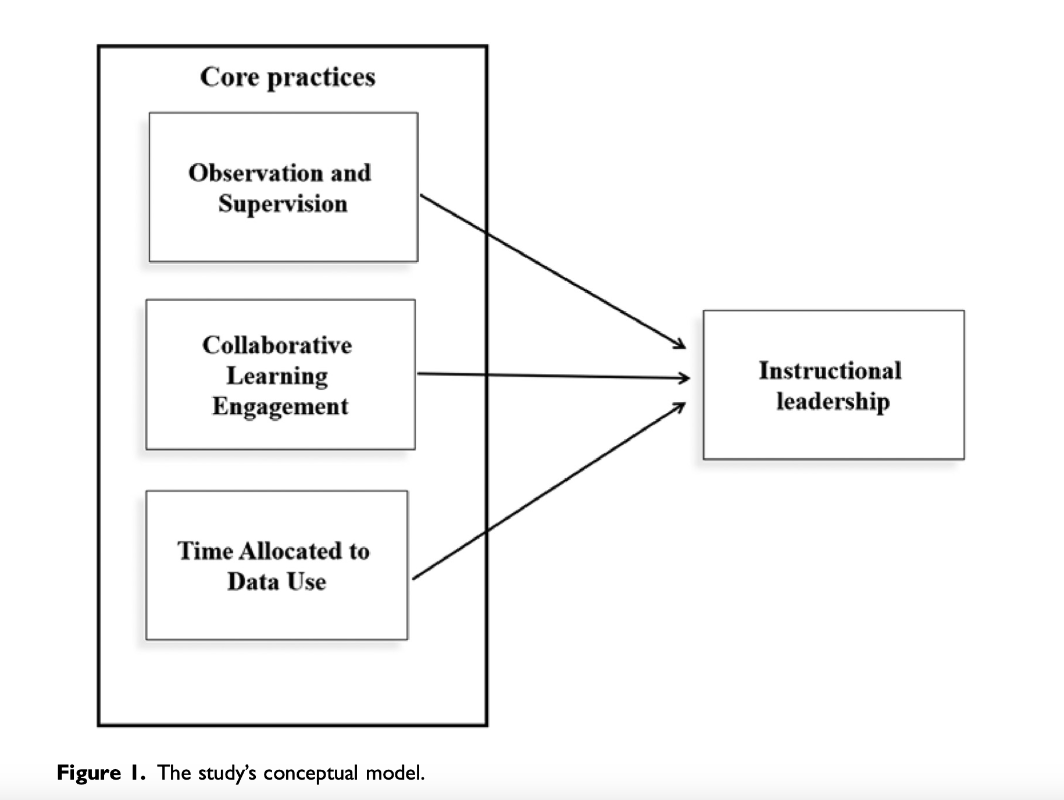

Slide 32
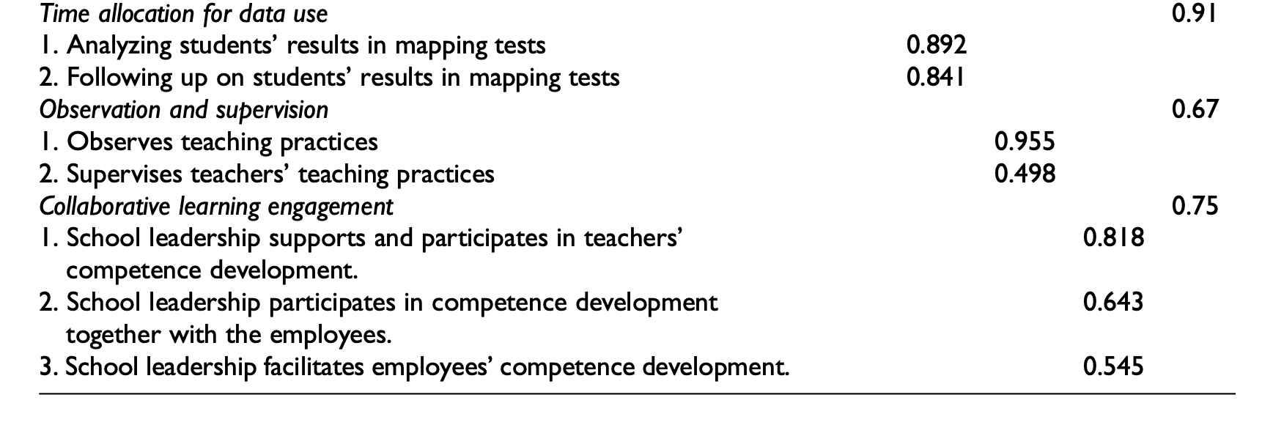

Slide 33
.347**
.466**
.239**

Slide 34
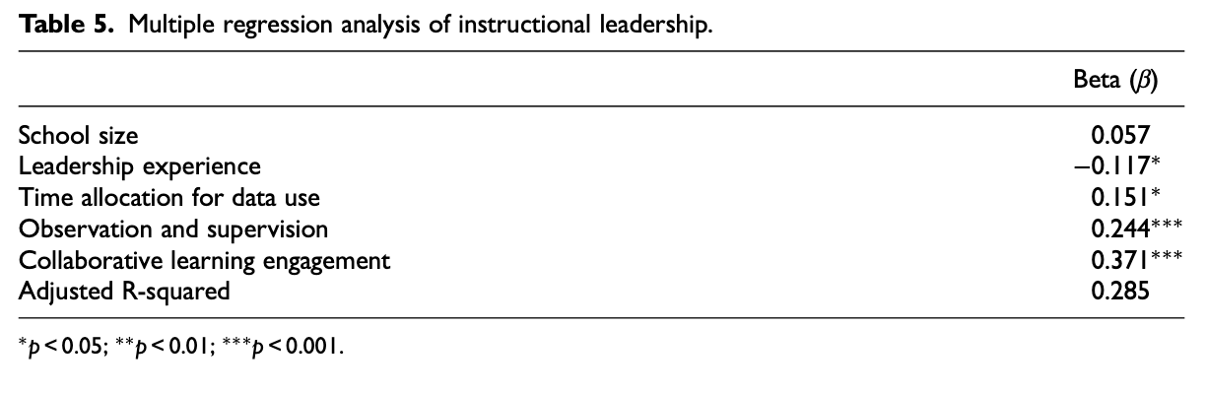

Slide 35
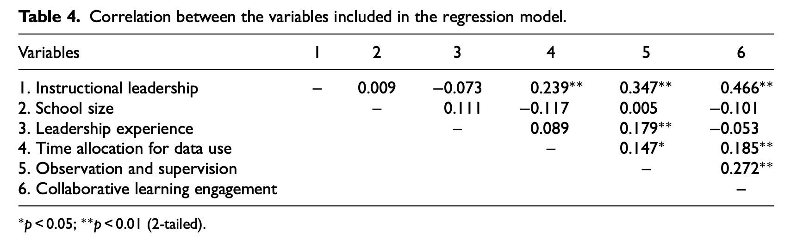

Slide 36
Key findings
28.5% of the variance in school leader’s capacity for engaging in instructional leadership was explained by the three distinct factors:
  observation and supervision
  collaborative learning engagement with teachers
  time allocation for data use.

Slide 37
Implications
The context-sensitive nature of core practices
Instructional leadership as a learning endeavor

Slide 38
Reflections
What is your understanding of the study?
How does the study relate to your context?

Slide 39
Presentation 3
Web-based knowledge resource –
A tool in school-based competence development

Slide 41
Context of the study
In 2017, the Norwegian government introduced a new model for professional development in schools.
The overall aim of this model is to raise quality and equity.
Guidelines from the Norwegian government:
  The professional development should be school-based.
  The professional development must take place in a partnership between the school owner and a university

Slide 42
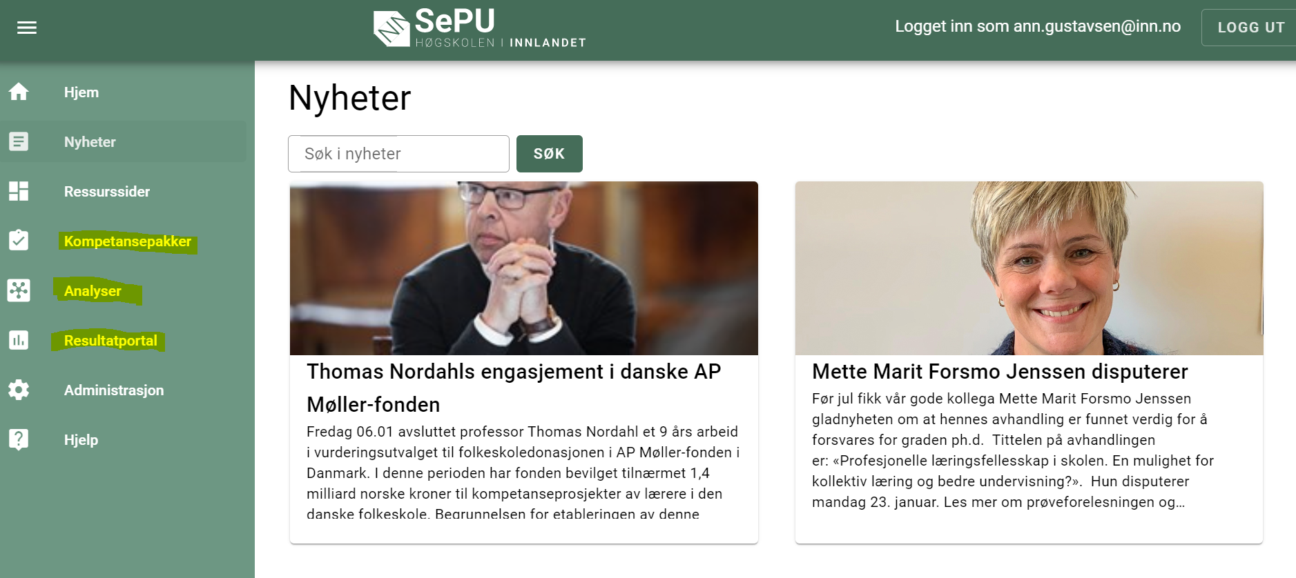
SePU’s web-based knowledge resources
Data results portal
A digital tool for Pedagogical analysis
Online courses

Slide 43
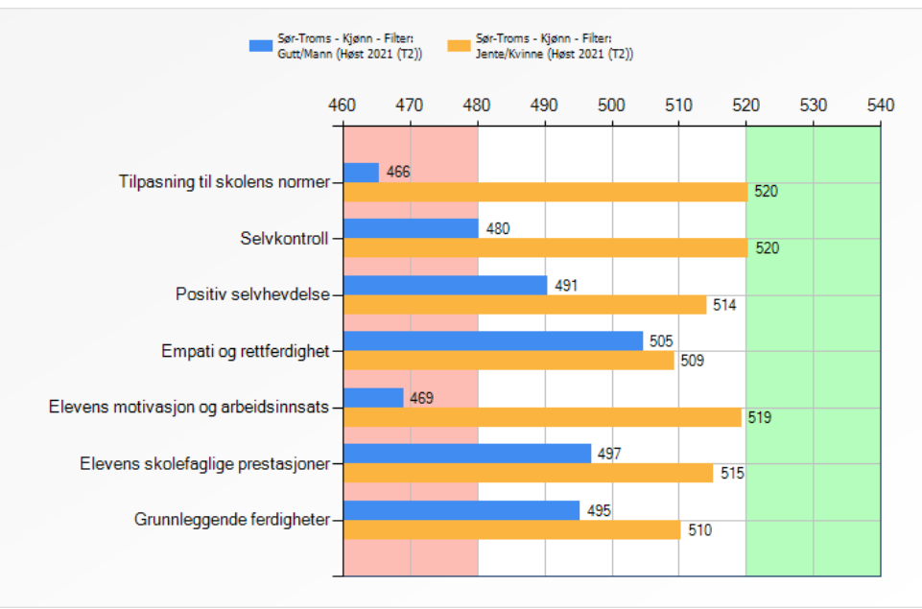
1. Data results portal
Data results for those schools that participate in a survey.
They find their results, compared with other participants:
  How the pupils experience their everyday life at school.
  How their contact teacher assesses their social and academic achievement.
  How the parents perceive the cooperation with the school.
  How the teachers and school leaders assess their working situation and pedagogical practice.

Slide 44
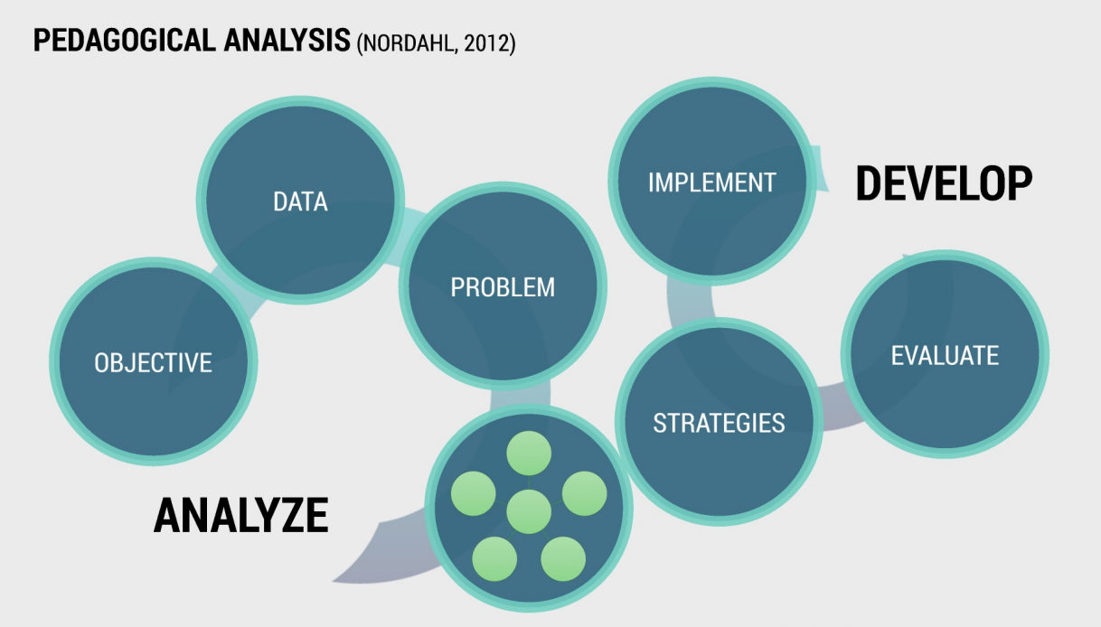
2. Digital tool for Pedagogical analysis

Slide 45
3. Online courses
An online course consists of several modules
  Different topics (ie. Feedback)
  Timeframe is usually one school year
A module consists of:
  Preparatory work (individual)
    Reading literature
    Watch a film clip
    Do an analysis
  Tasks in the meeting (PLC)
    Individual and group reflections about the preparatory work or own practice
    Discussions
  Tasks between meetings (individual or in pairs)
    Training of pedagogical skills

Slide 46
Research questions
In what way are the web resource perceived to be a support for teachers and school leaders?
Gustavsen, A.M., Løken, G. og Nordahl, S. (2022). Nettbasert kunnskapsressurs som verktøy i barnehage- og skolebasert kompetanseutvikling. Elverum: Høgskolen i Innlandet 2022 s. 171-199: https://brage.inn.no/inn-xmlui/bitstream/handle/11250/2996227/Skriftserien15_2022_Online.pdf?sequence=5&isAllowed=y

Slide 47
Findings
They perceive that the web-based knowledge resource support:
  their reflection, by in example changing their perspective.
  for creating common attitudes in school.
  for developing of knowledge and skills (like using data, analytical skills and competence to implement measures.)
  organization of the professional development, by having a clear structure (PLC, how many meetings a year, describing of tasks under and between meetings, and so on).
But they also say that a support from a web-based knowledge resource is not enough in their professional development.

Slide 48
SePU's contribution to the partnership
They say that it is also important that SePU support schools in their quality assessment and quality development by in example:
Workshops for:
  Teachers
  School leaders
  School owners
Supervising
Participates in project group meetings to plan and evaluate activities in partnership with school owners.

Slide 49
Reflections
What is your understanding of the study?
How does the study relate to your context?

Slide 50
Wrap up
What are your take-aways from this symposium?

Slide 51
https://www.inn.no/sepu/
hilde.forfang@inn.no
lars.myhr@inn.no
ann.gustavsen@inn.no

